Slide 1
Agenda
Homework:
Line Of Best Fit WS
CN Summary
AM
DO NOW
On your DESK:
Create the equation for the line that passes between the points (3, 24) & (12, 18)
Materials:
Calculator
Ruler
Notes:
Hey

Slide 2
Homework
Scatterplots WS

Slide 3
Set up Cornell Notes
Topic: Scatterplots – Line of Best Fit
EQ: Explain how to determine the symbolic representation for the line of best fit and how you would use it to analyze data in a scatterplot.
Update Table of Contents:
11/12/15 (Pd 6) 11/13/15 (Pd 3) | Scatterplots- Line of Best Fit

Slide 4
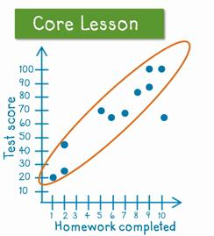
What is an outlier?
An outlier is a value that lies outside (much smaller or larger) most of the other points in a set
outlier

Slide 5
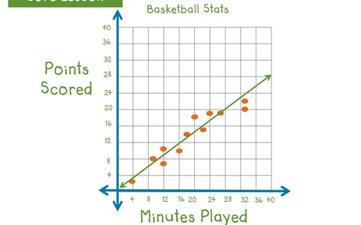
What is the “line of best fit”?
A line that shows the trend of the collected data

Slide 6
What is purpose of the “line of best fit”?
To PREDICT unobserved data
http://learnzillion.com/lessons/1203-draw-a-line-of-best-fit

Slide 7
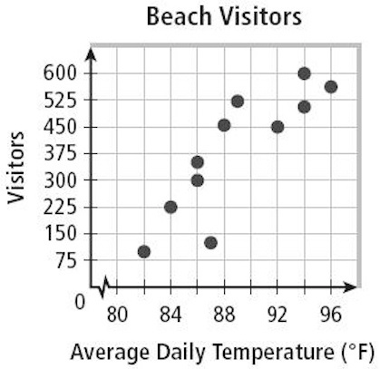
How do you determine the symbolic form of the “line of best fit”?
Draw an oval around your points (EXCLUDE outliers)
Connect the two farthest points on your oval with a straight line
Pick two points ON your line to use to find the symbolic representation
(86, 300)
& (90, 450)

Slide 8
How do you determine the symbolic form of the “line of best fit”?
m = y₂ - y₁ x₂ – x₁
Find the slope of the two points: (86, 300) & (90, 450)
Use one of the points and the slope to find b
Plug in m & b
= 450 - 300 90 - 86
= 75
2
= 150
4
f(x) = m x + b
75 2
300
75 2
(86)
300 = m x + b
3225
- 3225
- 3225
- 2925
= b
- 2925
f(x) = m x + b

Slide 9
Stationwork
Worksheets

