Slide 1
Quarter 1
Snapshot

Slide 2
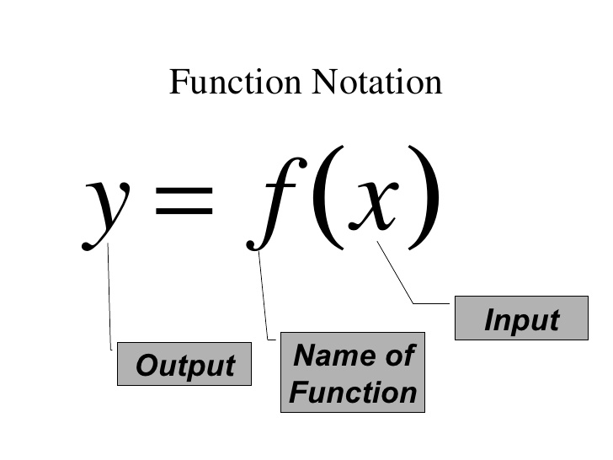
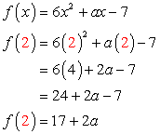
Math Goggle Upgrades
Functions
Function Notation
Each x, has only 1 y
Evaluating a function
Plugging in for f(x)
Verifying a solution to a function
4 Representations of a function
In Context
Symbolic
Table
Graphs

Slide 4
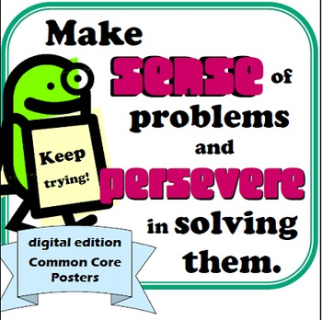
MP #1 – Never Give Up

